Slide 1
Data Management as Part of a Research Workflow
Gareth Cole, Loughborough University

Slide 2
Who am I?
Research Data Manager at Loughborough since March 2015
Data Curation Officer at University of Exeter between October 2011 and February 2015
PhD Maritime History (Exeter) – 2008: “The Office of Ordnance and the arming of the Fleet in the French Revolutionary and Napoleonic Wars, 1793-1815”
@DrGarethCole
ORCID: https://orcid.org/0000-0001-7493-0137

Slide 3
What is/are research data?
Research data are the evidence that underpins the answer to the research question, and can be used to validate findings regardless of its form (e.g. print, digital, or physical). These might be quantitative information or qualitative statements collected by researchers in the course of their work by experimentation, observation, modelling, interview or other methods, or information derived from existing evidence. Data may be raw or primary (e.g. direct from measurement or collection) or derived from primary data for subsequent analysis or interpretation (e.g. cleaned up or as an extract from a larger data set), or derived from existing sources where the rights may be held by others. Data may be defined as ‘relational’ or ‘functional’ components of research, thus signalling that their identification and value lies in whether and how researchers use them as evidence for claims.
They may include, for example, statistics, collections of digital images, sound recordings, transcripts of interviews, survey data and fieldwork observations with appropriate annotations, an interpretation, an artwork, archives, found objects, published texts or a manuscript.

Slide 4
Data Management Plan / Technical Plan
“Plans typically state what data will be created and how, and outline the plans for sharing and preservation, noting what is appropriate given the nature of the data and any restrictions that may need to be applied.”

Slide 5

Why is data management important?

Slide 6
Why have a plan 1
Research efficiency
Aids collaboration and sharing
Try to anticipate problems before they arise

Slide 7
Why have a plan 2
You have an “Intellectual Plan” why not a “Technical Plan”?
Ensure you have permission to do everything you want to do
Ensure you have enough resource to do everything you want to do
Plans should be dynamic – your research changes, technologies/solutions change

Slide 8
The sticks…
Funder requirements
As part of grant application
Once grant has been approved
Different funders have different requirements
Publisher requirements
Notes:
State that more on these later

Slide 9
Areas to think about in a plan 1
Use of existing data
“Do I need to create/collect new data?”
Storage
Backup
Ethics, legal, and licences
Notes:
Expand and elaborate

Slide 10
Areas to think about in a plan 2
Version control
Quality control
Collaborative work – sharing during project
Responsibilities
Resources and costs

Slide 11
General hints and tips
Be realistic
Cover all the data/information you will collect and create
Be as specific as possible
Justify any resources needed
Don’t overthink it

Slide 12
Tools and support available
DMPonline – UK
DMPtool – US
Mantra – University of Edinburgh
RDM Mooc
Local institutional support
DCC guidance
DCC DMP checklist - http://www.dcc.ac.uk/resources/data-management-plans/checklist

Slide 13
Write your own DMP
Use DMPonline (if you have access to a laptop) to write your own DMP
What are the important areas for you?
Notes:
Go through and write your own plan. Discuss in groups/tables what should be in it

Slide 14
Knowing the Vocabulary – Data Management & Grant Capture
Gareth Cole, Loughborough University

Slide 15
Define the followings terms and phrases
Data Protection Act
Sensitive data
Third Party Copyright
Embargo period
Creative Commons Licences
Open/proprietary formats
Data preservation
Data sustainability
Data access statement / statement on access to the underlying research materials
Data Archiving / data publishing
Notes:
DPA: “The Data Protection Act controls how your personal information is used by organisations, businesses or the government. Everyone responsible for using data has to follow strict rules called ‘data protection principles’. They must make sure the information is:
used fairly and lawfully
used for limited, specifically stated purposes
used in a way that is adequate, relevant and not excessive
accurate
kept for no longer than is absolutely necessary
handled according to people’s data protection rights
kept safe and secure
not transferred outside the European Economic Area without adequate protection”
Sensitive data: “There is stronger legal protection for more sensitive information, such as:
ethnic background
political opinions
religious beliefs
health
sexual health
criminal records”
TPC: “Third party copyright refers to copyright works created by someone other than yourself. Examples include text, images and graphs.”
Embargo period: Period when information about the item is available (usually) but not the item itself.
CC Licences: Used to licence work and to show what can and can’t be done with it e.g. CC-BY; CC-BY-NC etc.
Open/Proprietary formats: “A proprietary format is a file format of a company, organization, or individual that contains data that is ordered and stored according to a particular encoding-scheme, designed by the company or organization to be secret, such that the decoding and interpretation of this stored data is only easily accomplished with particular software or hardware that the company itself has developed. The specification of the data encoding format is not released”
Data Preservation: “Data preservation, or more specifically, digital data preservation, refers to the series of managed activities necessary to ensure continued access to digital materials for as long as necessary. This broad definition of data preservation refers to all of the actions required to maintain access to digital materials beyond the limits of media failure or technological change. Long-term preservation can be defined as the ability to provide continued access to digital materials, or at least to the information contained in them, indefinitely.” http://ifdo.org/wordpress/preservation/
Data Sustainability: Data is still useable and operates in the same way as when it was created e.g. Interactive website
Data access statement: outlines to a reader where and under what conditions the underlying research data is made available/accessible.
Data Archiving / Data Publishing – data is deposited in a repository or archive and made accessible to a wider audience. It doesn’t have to be openly available.

Slide 16
Funder requirements
Exercise on can you find your funder requirements and do you know what they mean!
AHRC
ESRC
H2020
Wellcome Trust
British Academy

Slide 17
Main UK funder requirements
Data should be as open and as accessible as possible
Legal, ethical, commercial exceptions allowed
E.g. breaching the privacy of your participants; breaching an agreement with a commercial partner; Patents
Data should be preserved and sustained for a set (depends on funder…) number of years
Data should be made available with a Persistent Unique Identifier (e.g. DOI) where possible

Slide 18
Publisher requirements
Predominantly STEM publishers but others encourage e.g. T&F
PLOS
Royal Society
Springer
Nature Publishing Group

Slide 19
Funder pages with requirements
AHRC
ESRC
Wellcome Trust
British Academy
No one policy – sections in grant proposals
H2020
Leverhulme
“Proposals in which the balance between assembling a data bank or database and the related subsequent research is heavily inclined to the former” are not funded

Slide 20
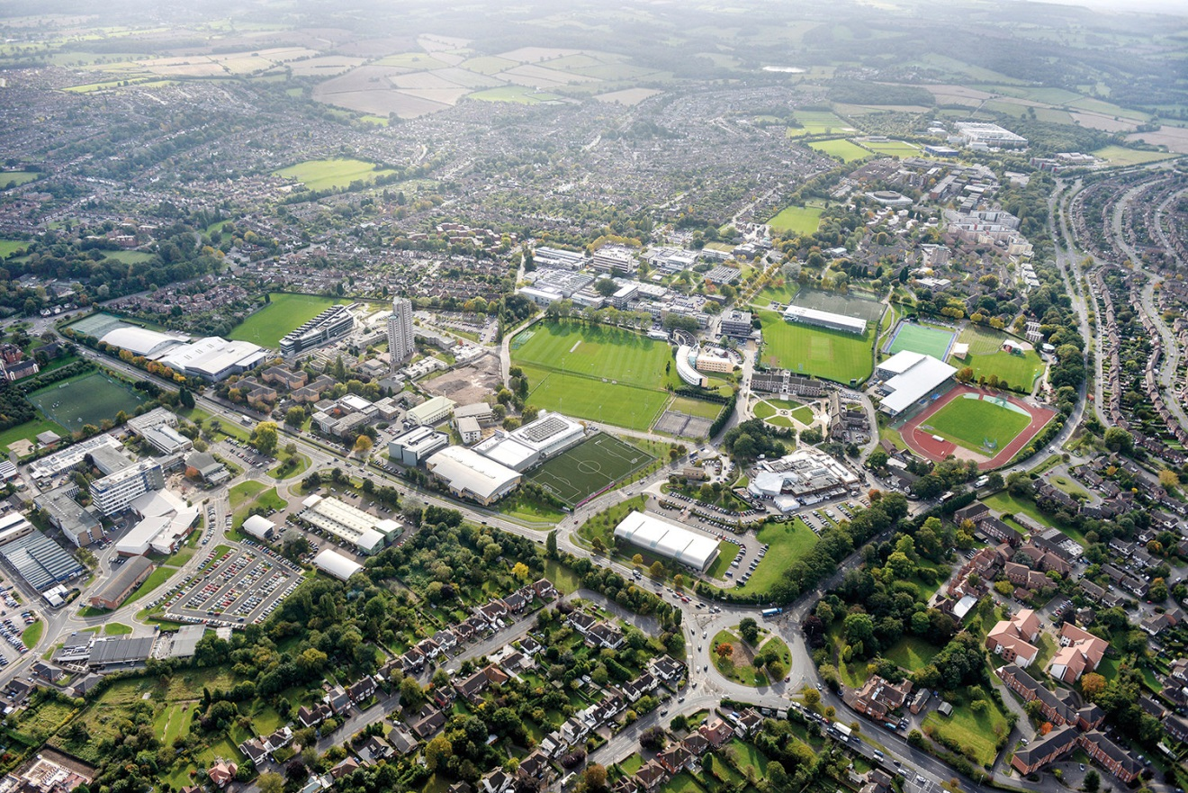
Our outstanding campus
Largest single site green campus in the UK

